Slide 1
CSE 474
Pattern Recognition Sessional
Lab# 1: Implementation of a Bayesian Classifier

Slide 2
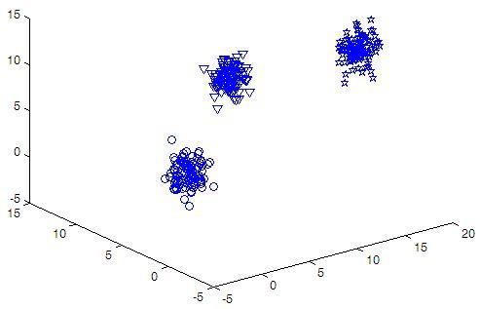
Bayes Classifier
Assume following training set is given
  3 classes
  3 features

Slide 3
Bayes Classifier
Assume following training set is given
  All numerical data
  NO assumption for
  conditionally independence
F1 F2 F2 Class
9.4512 7.3199 6.4664 1
10.7276 9.6067 5.9398 3
10.1960 9.3145 8.3873 1
15.7777 1.5879 11.4440 2
15.8685 2.7902 11.2532 3
14.9448 0.7798 12.7481 2

Slide 4
Bayes Classifier
Given an unknown sample,
F = [F1, F2, F3] = [10.1960 9.3145 8.3873]
Predict its class!

Slide 5
Naïve Bayes Classifier
Given an unknown sample,
F = [F1, F2, F3] = [10.1960 9.3145 8.3873]
Predict its class!
Calculate posterior probabilities for each class C_{i}
P(C_{i}| F1,F2,F3) ~ = P(C_{i}) P([F1,F2,F3]|C_{i})

Slide 6
Bayes Classifier
Given an unknown sample,
F = [F1, F2, F3] = [10.1960 9.3145 8.3873]
Predict its class!
Calculate posterior probabilities for each class C_{i}
P(C_{i}| [F1,F2,F3]) ~ = P(C_{i}) P([F1, F2, F3 ]|C_{i})
Assign [F1, F2, F3] to C_{i} if P(C_{i}| [F1,F2,F3])> P(C_{j}| [F1,F2,F3]) for all j

Slide 7
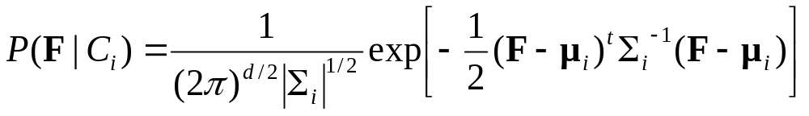
Bayes Classifier
To estimate P([F1, F2, F3 ]|C_{i}), assume F=[F1, F2, F3] follows multivariate Gaussian distribution
F1 F2 F2 Class
9.4512 7.3199 6.4664 1
10.7276 9.6067 5.9398 3
10.1960 9.3145 8.3873 1
15.7777 1.5879 11.4440 2
15.8685 2.7902 11.2532 3
14.9448 0.7798 12.7481 2

Slide 8
Bayes Classifier
Separate training data according to class
For each class, estimate μ_{i} = [μ_{i1}, μ_{i2}, μ_{i3}]and covariance matrix Σ_{i} from train samples only
For covariance matrix Σ_{i}, you can use library function
F1 F2 F2 Class
9.4512 7.3199 6.4664 1
10.1960 9.3145 8.3873 1
μ₁₁ μ₁₂ μ₁₃

Slide 9
Bayes Classifier
Priors, P(C_{i}), can be easily estimated by counting the no. of training samples of the corresponding classes
F1 F2 F2 Class
9.4512 7.3199 6.4664 1
10.7276 9.6067 5.9398 3
10.1960 9.3145 8.3873 1
15.7777 1.5879 11.4440 2
15.8685 2.7902 11.2532 3
14.9448 0.7798 12.7481 2

Slide 10
Bayes Classifier
Training File: train.txt
  Use this file for training (estimating the Gaussian parameters and priors)
  File format:
    first line contains 3 integers m n p. m= no. of features, n= no. of classes, p=no. of samples
    Each of next p lines contains m feature values followed by its class in integer

Slide 11
Bayes Classifier
Testing file: test.txt
  Format is identical but the first line is removed
  For each vector F =[F1, F2, F3] = [9.4512 7.3199 6.4664], find P(F|C_{i}) using
F1 F2 F2 Class
9.4512 7.3199 6.4664 1
10.7276 9.6067 5.9398 3
10.1960 9.3145 8.3873 1
15.7777 1.5879 11.4440 2
15.8685 2.7902 11.2532 3
14.9448 0.7798 12.7481 2

Slide 12
Bayes Classifier
Testing file: test.txt
  Use Bayesian rule to find predicted class
  Compare predicted and actual class and calculate % of accuracy
Assign F to C_{i} if P(C_{i}| F)> P(C_{j}| F) for all j

Slide 13
Bayes Classifier
Output:
  Identify all misclassified samples and report as follows
  sample no. feature values actual class estimated class
  % of accuracy

